Slide 1

ERAS protocol for Neurosurgery: when and how?
Prof. Dr. Rudin DOMI, MD, PhD, FESAIC
University of Medicine, Tirana, Albania

Slide 2
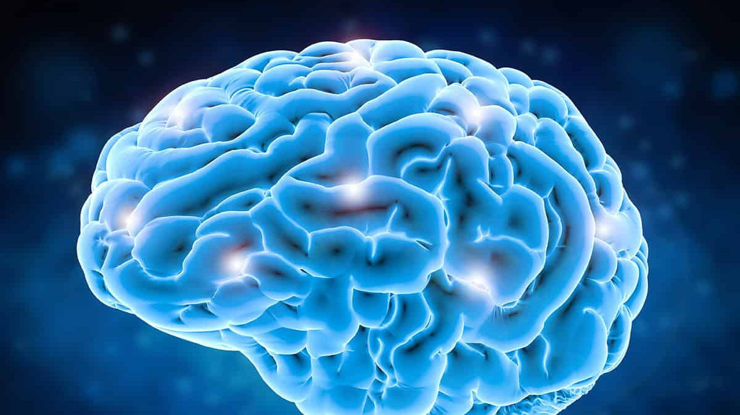


Slide 3
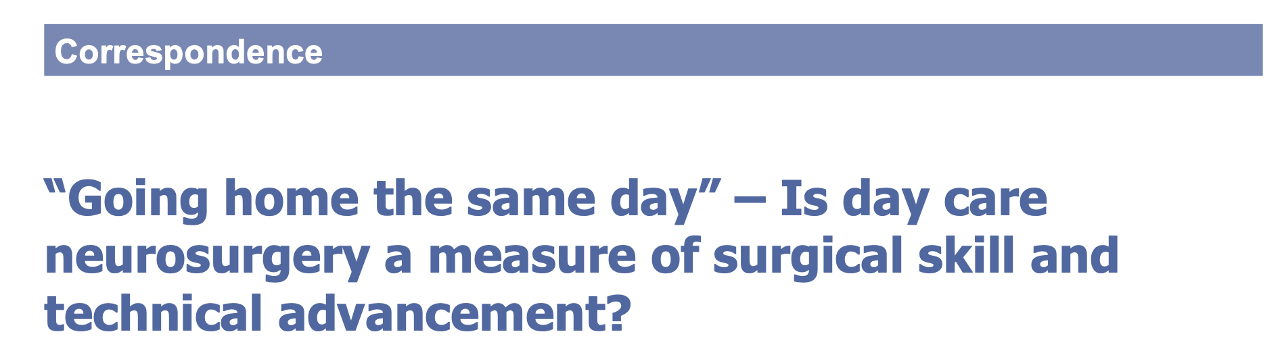
Day‑care stereotactic biopsy: 1996 in Toronto.
Bernstein’s series of day‑care craniotomy for gliomas in 2001
Vilanilam GC, Hari VS. “Going home the same day” – Is day care neurosurgery a measure of surgical skill and technical advancement?. Neurol India 2017;65:228-30.

Slide 4
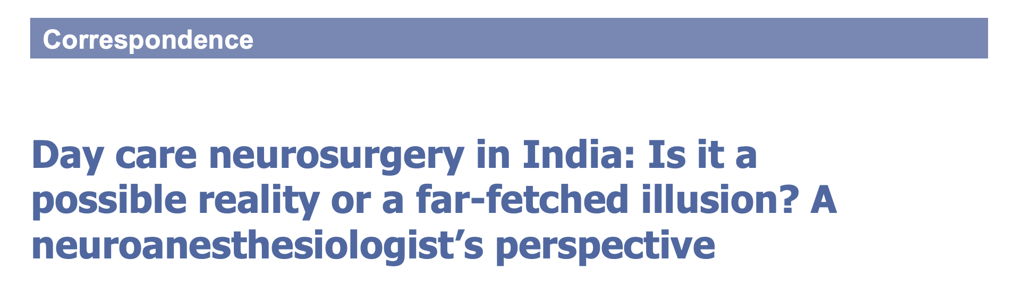
Nisha B, et al. Day care neurosurgery in India: Is it a possible reality or a far-fetched illusion? A neuroanesthesiologist's perspective. Neurol India 2019;67:938-41.
The primary aim is to facilitate early recovery and “home” environment
Possible reduction in the risk of thromboembolism and hospital‑acquired infections.
Day care surgeries reduce cost of treatment by up to 70%

Slide 5
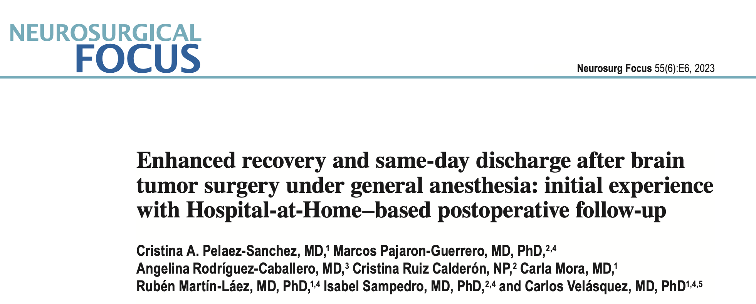
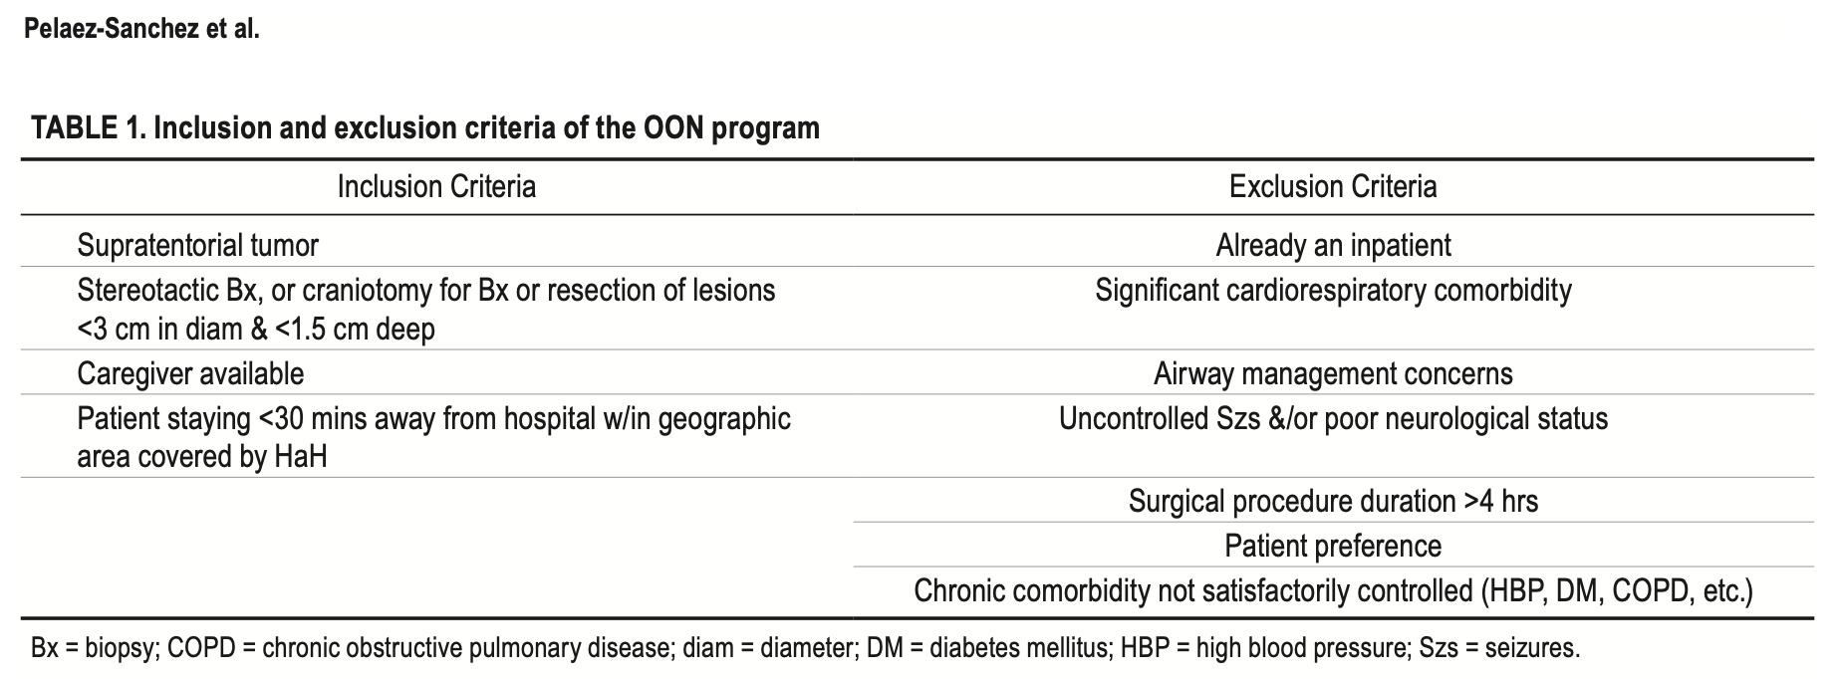
Indications for outpatient's oncologic neurosurgery (oon)

Slide 6
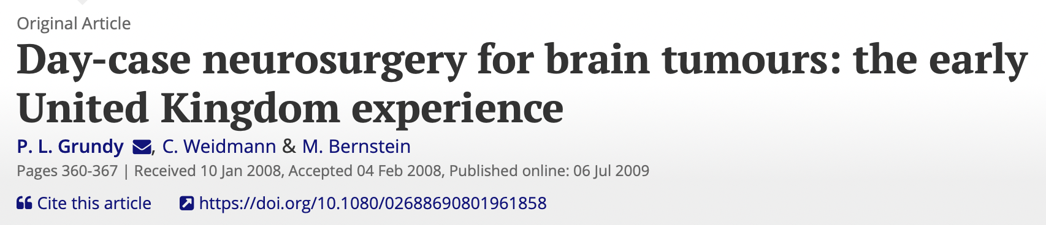
Day-case biopsy and craniotomy for brain tumors have been reported as safe the first UK series of day-case surgery for intra-axial tumors consisting of 30 image-guided biopsies and 11 craniotomies discharged 6 h postoperatively day-case surgery for brain tumors is a safe and feasible

Slide 7
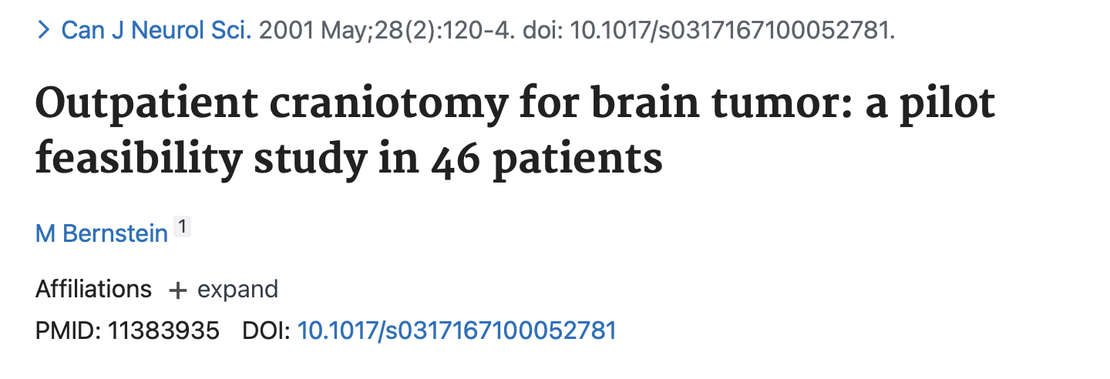
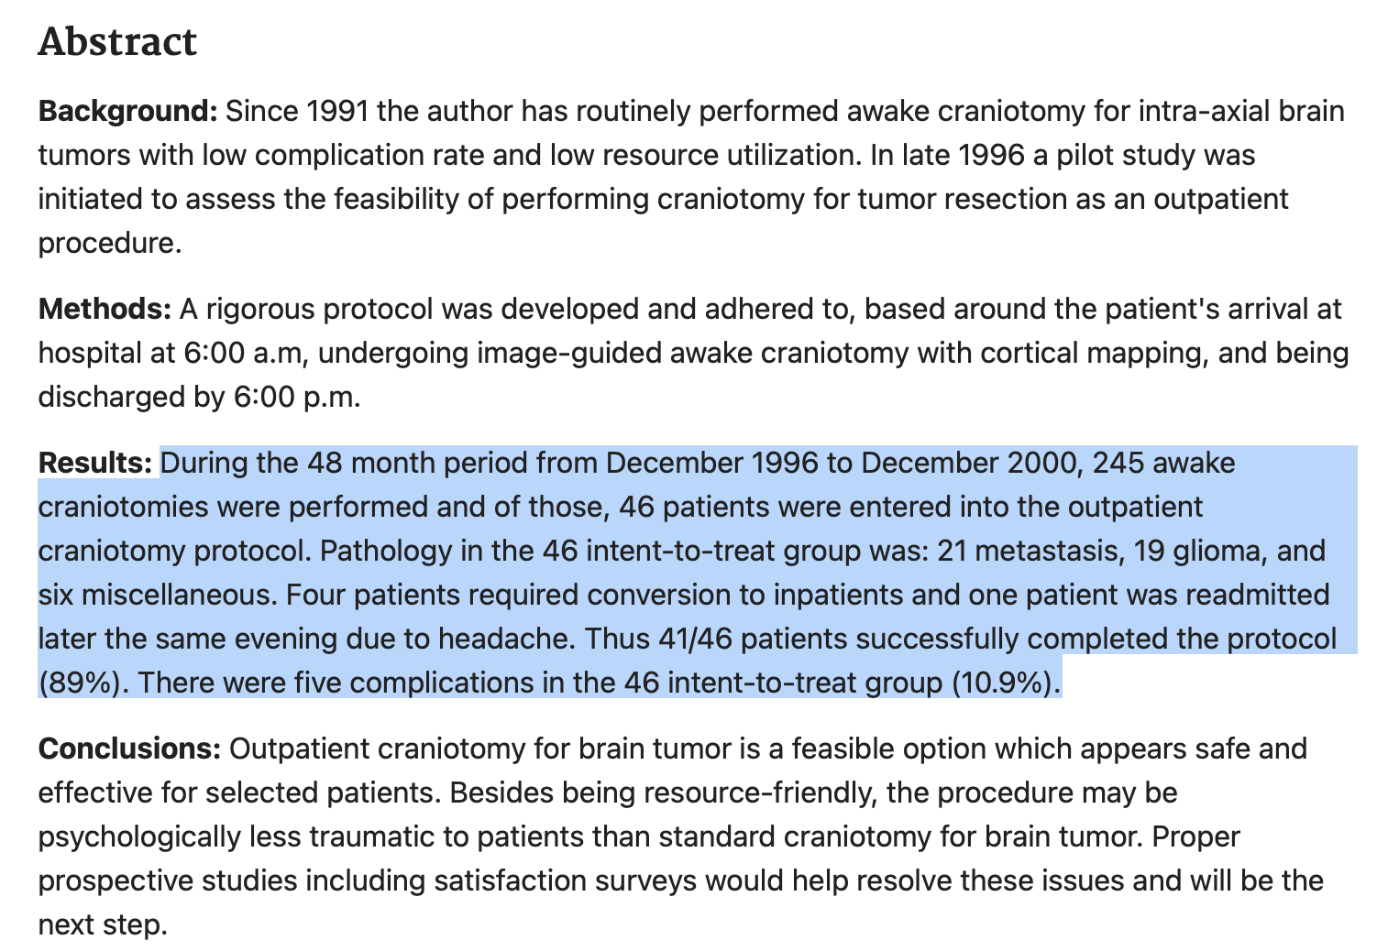

Slide 8
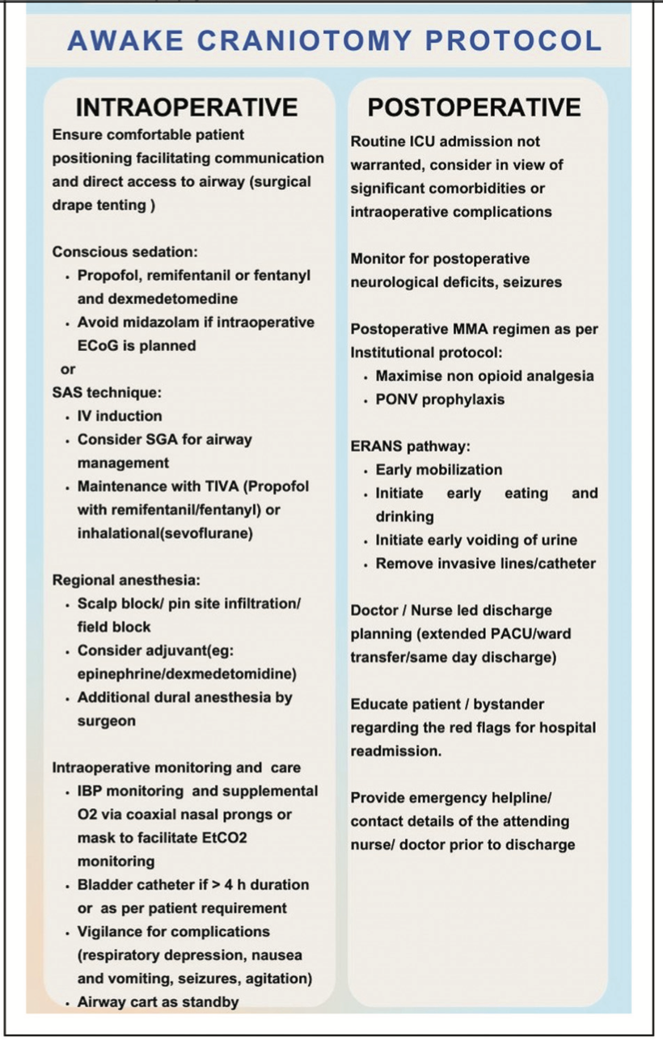
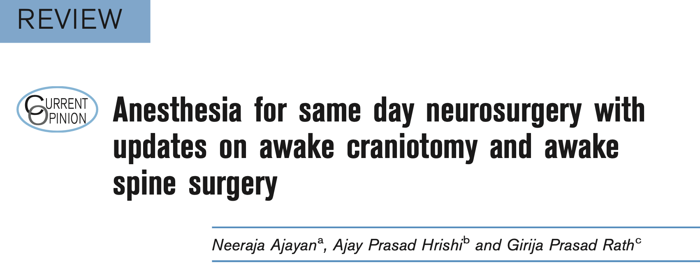
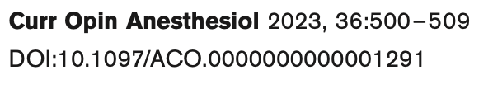

Slide 9
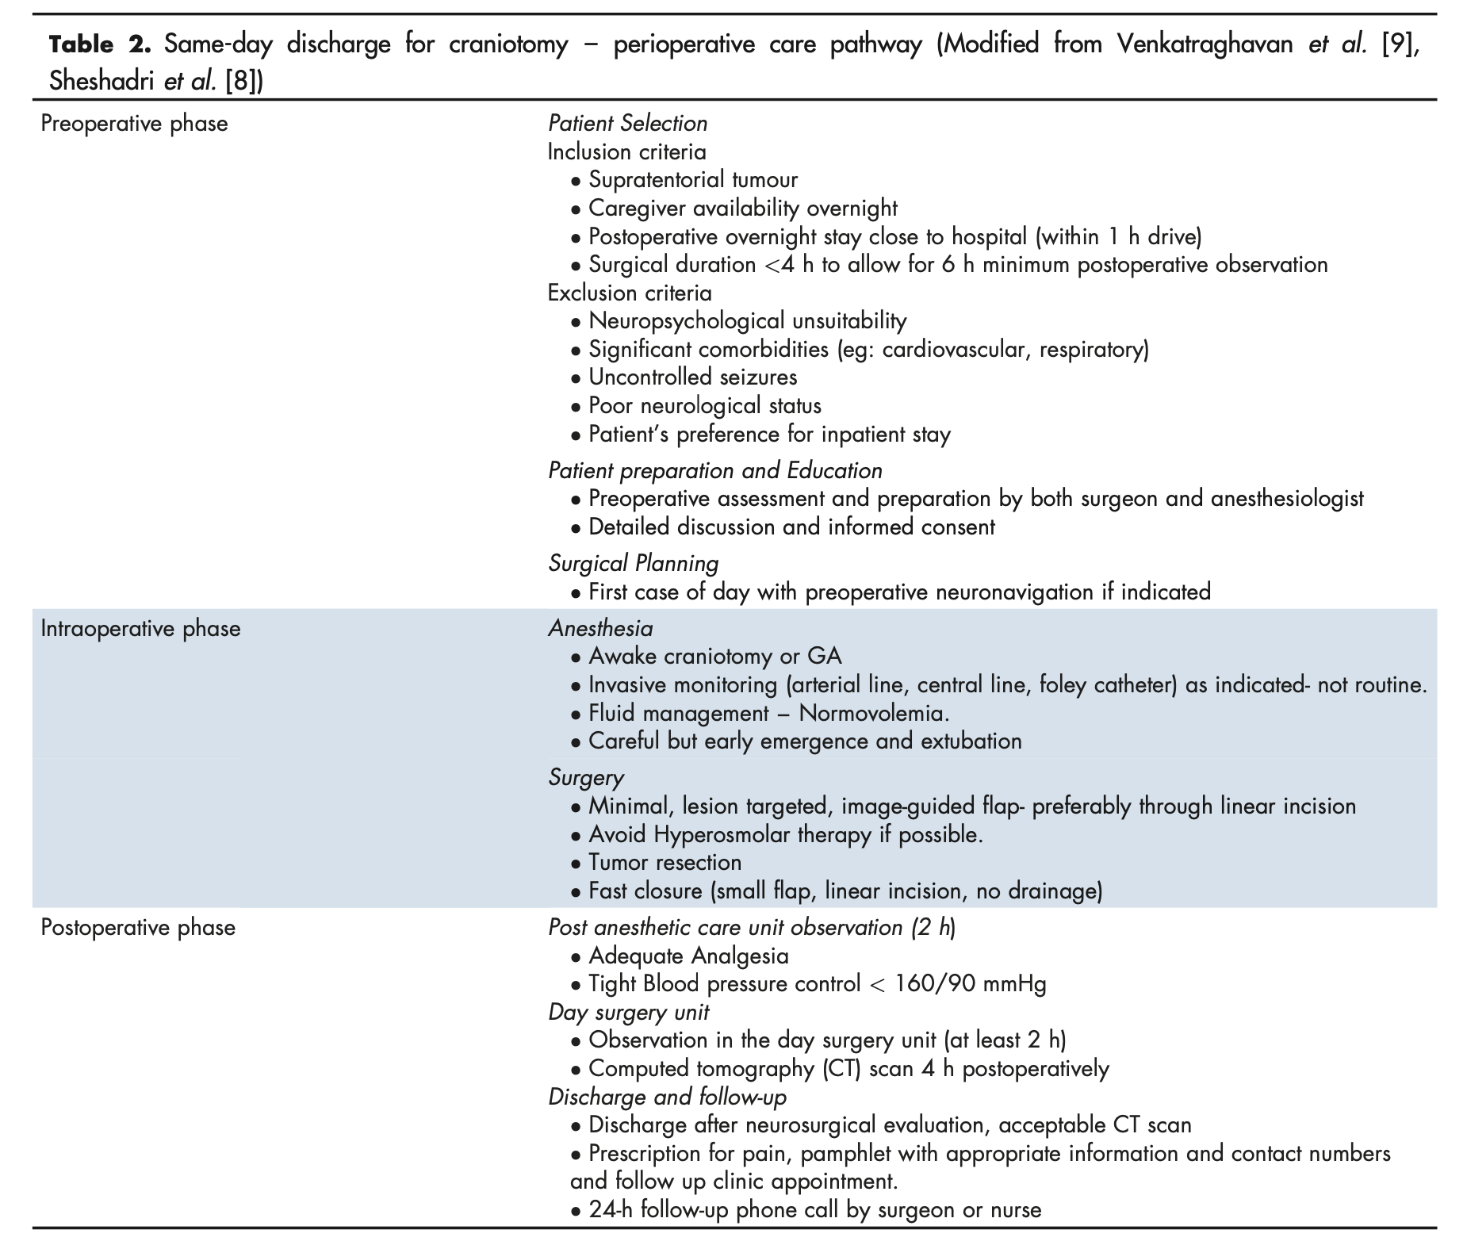
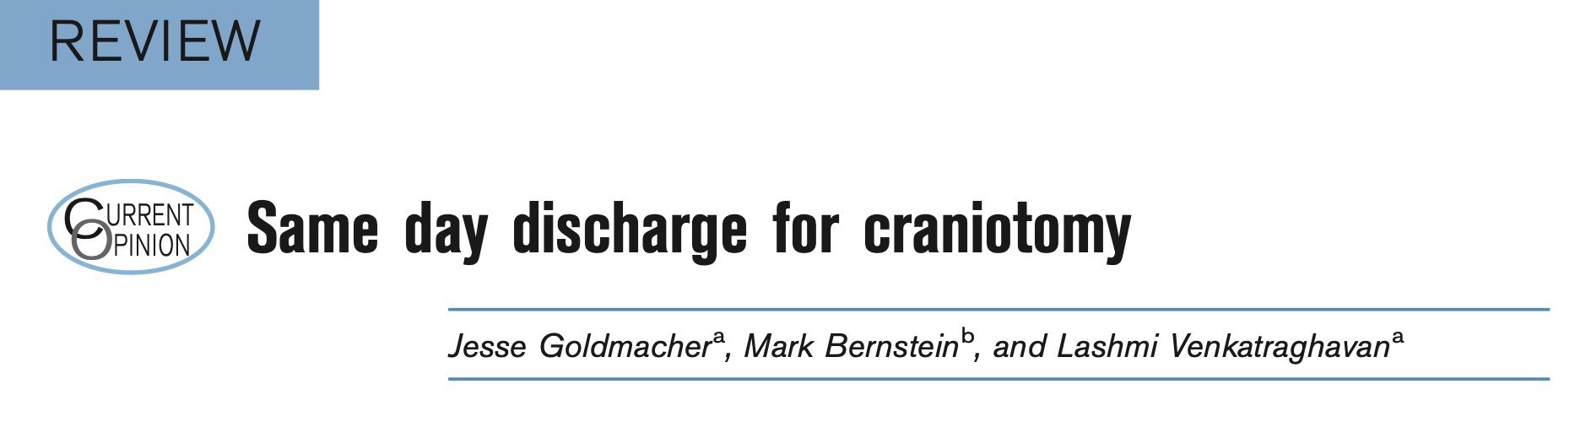
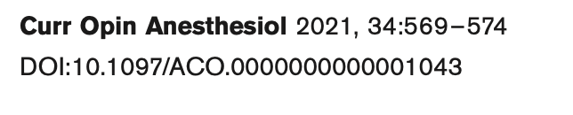

Slide 10
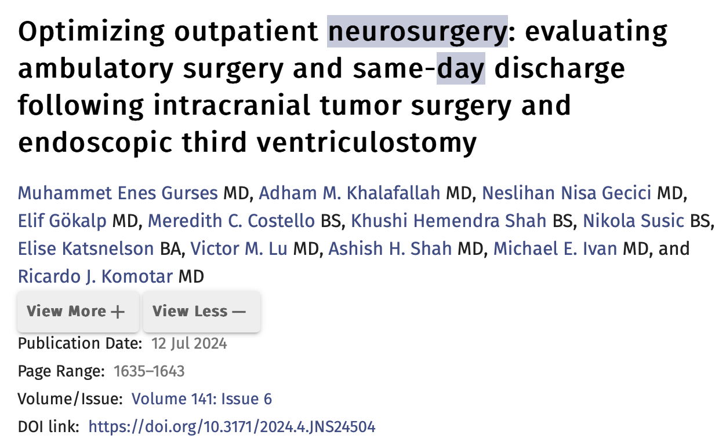
202 patients, mean age was 56.8 years metastasis (23.3%), meningioma (20.8%), glioblastoma (12.4%), and low-grade glioma (10.4%)
Craniotomy (46.5%), stereotactic needle biopsy (35.1), and ETV (6.9%)
6.4% awake craniotomy, 189 (93.6%) general anesthesia
Complications 1.5%
179 (88.6%) successfully discharged on the same day median length of postoperative stay being 7 hours.

Slide 11
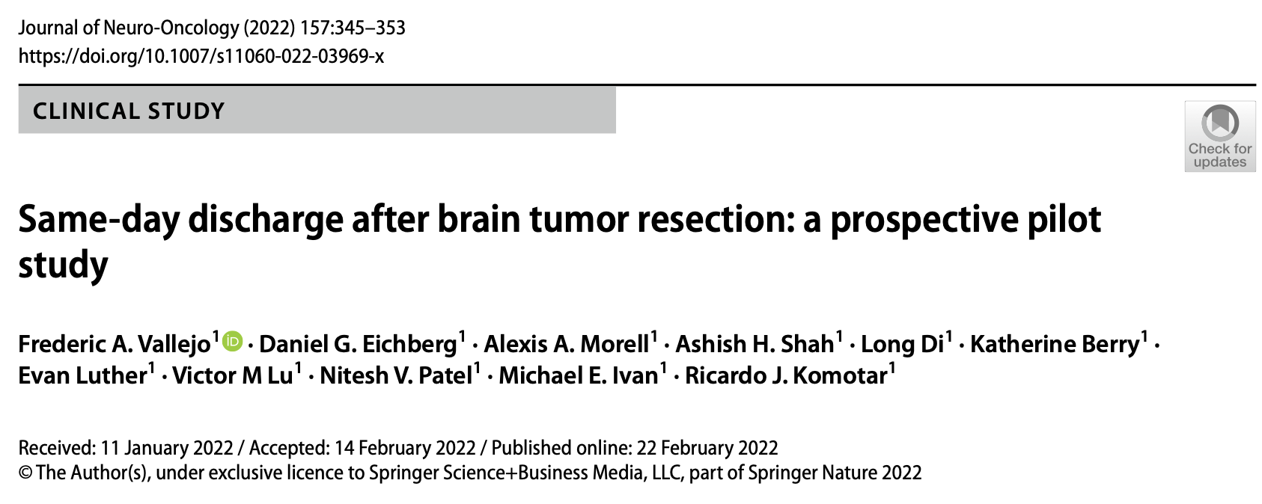
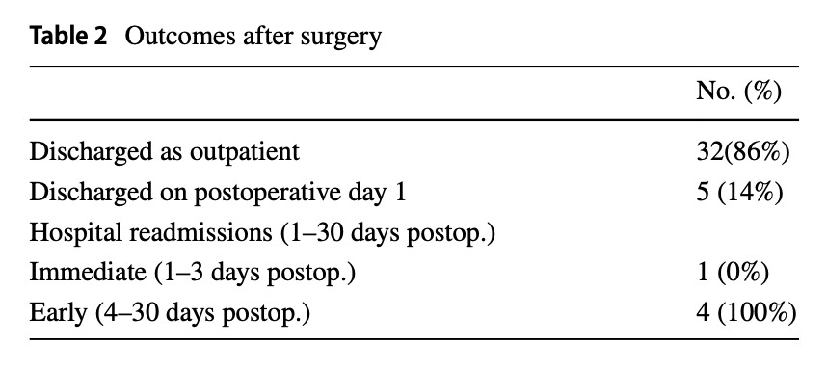
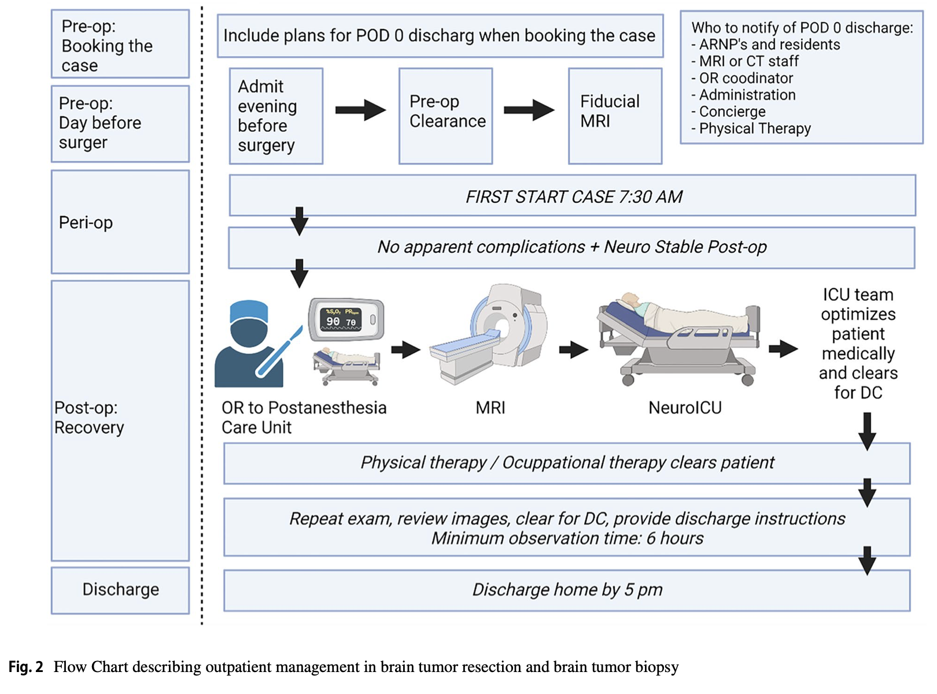
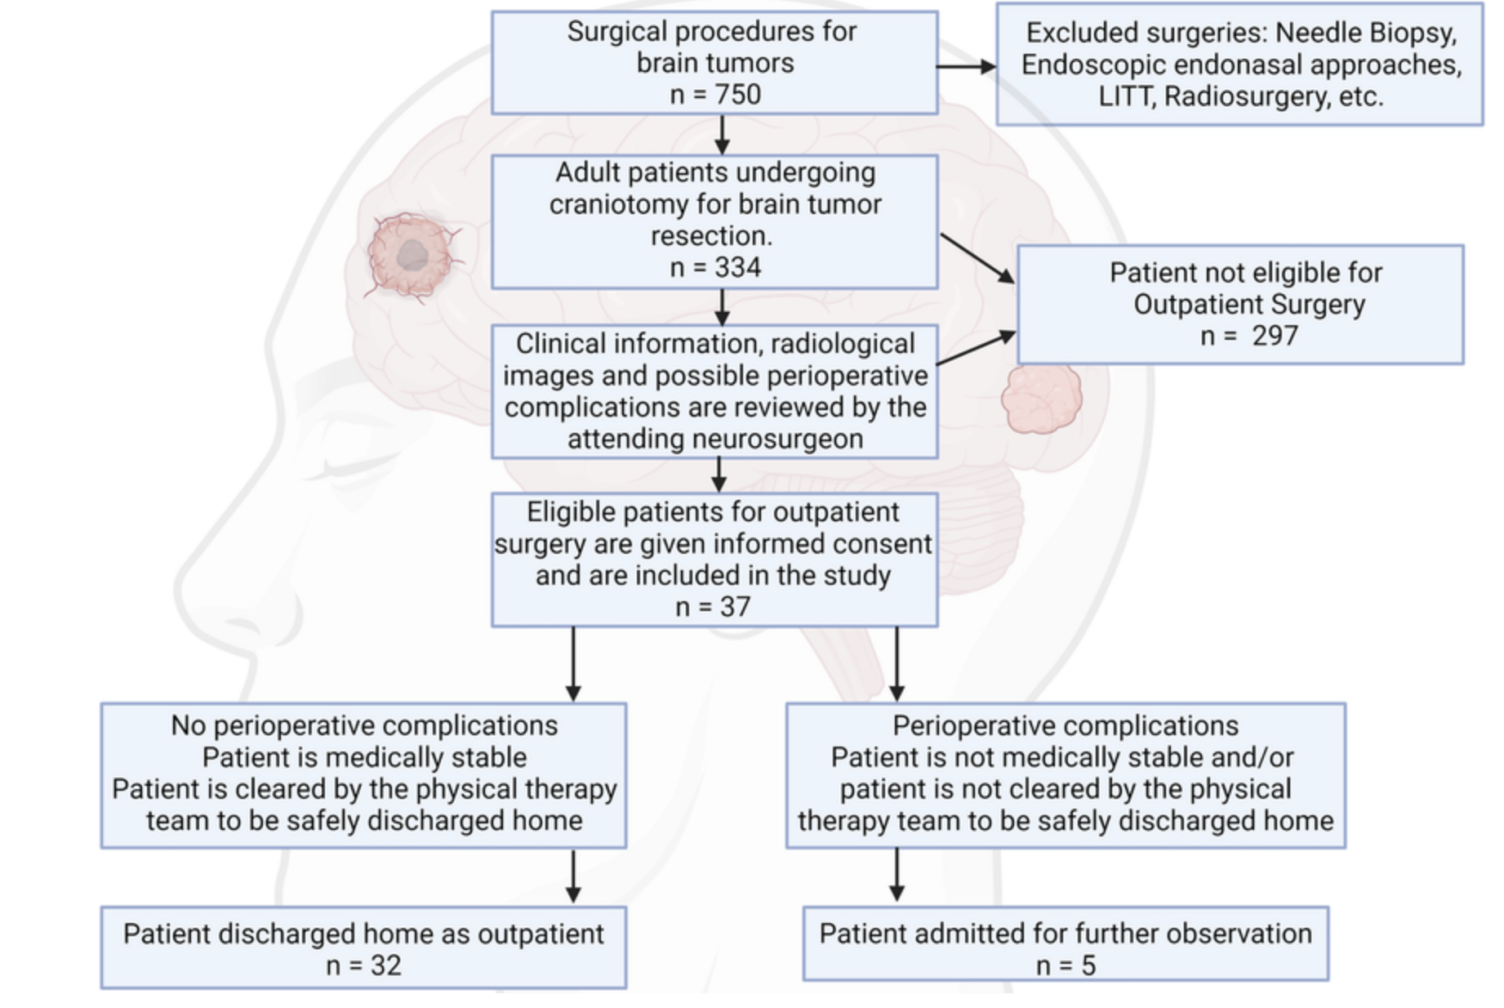

Slide 12
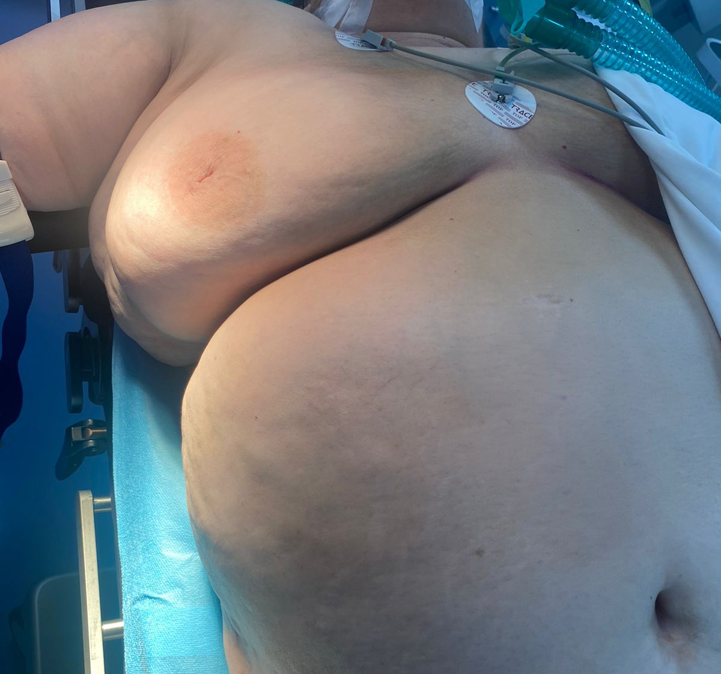
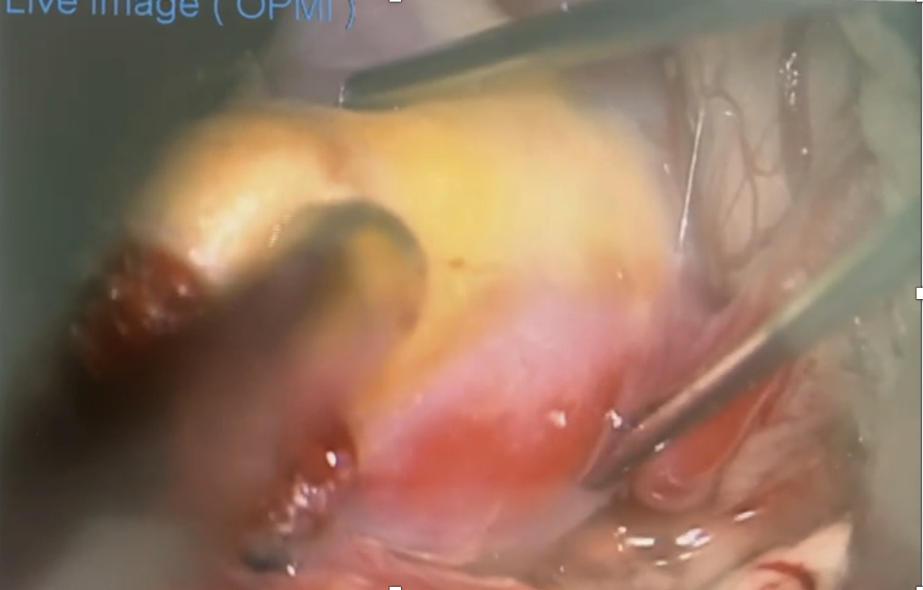
Original view / not fit to day-case BUT ERAS CAN HELP

Slide 13
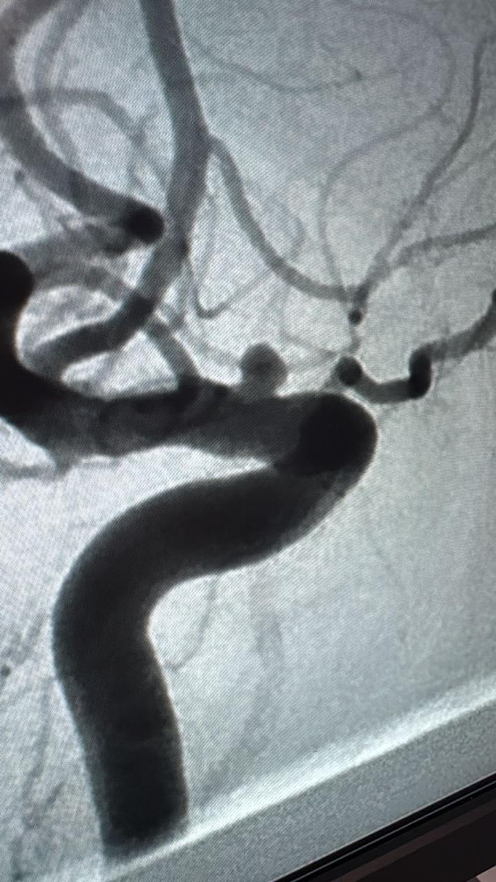
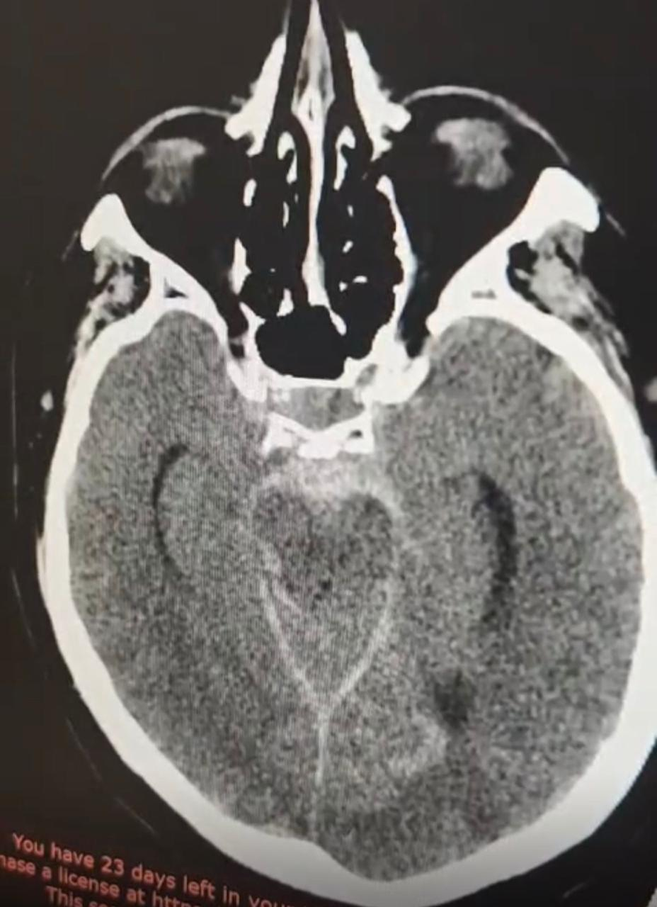
Super Obese for DSA under GETA (0RIGINAL VIEWS)
(POSTERIOR COMUNICANS Artery aneurism)ARTERY ANEURISM)

Slide 14
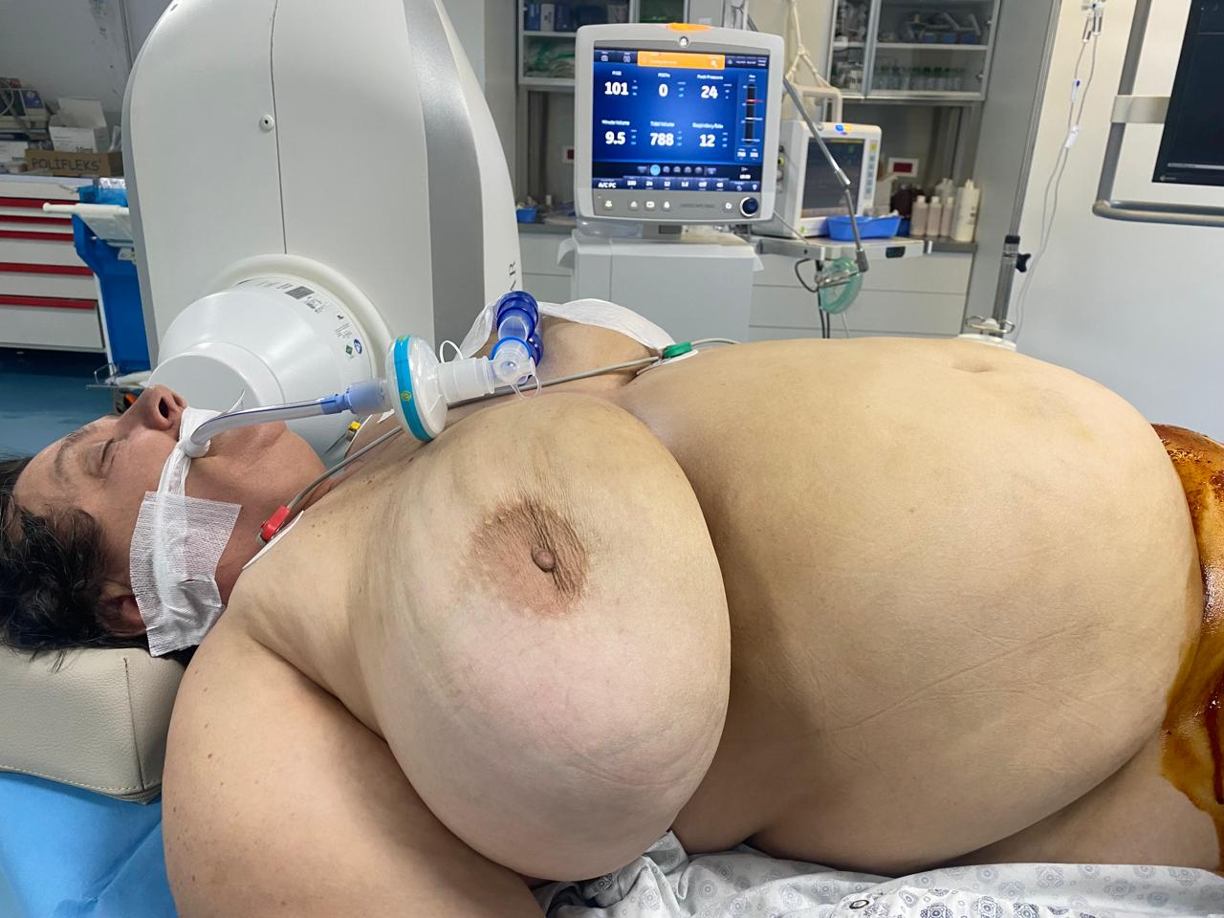
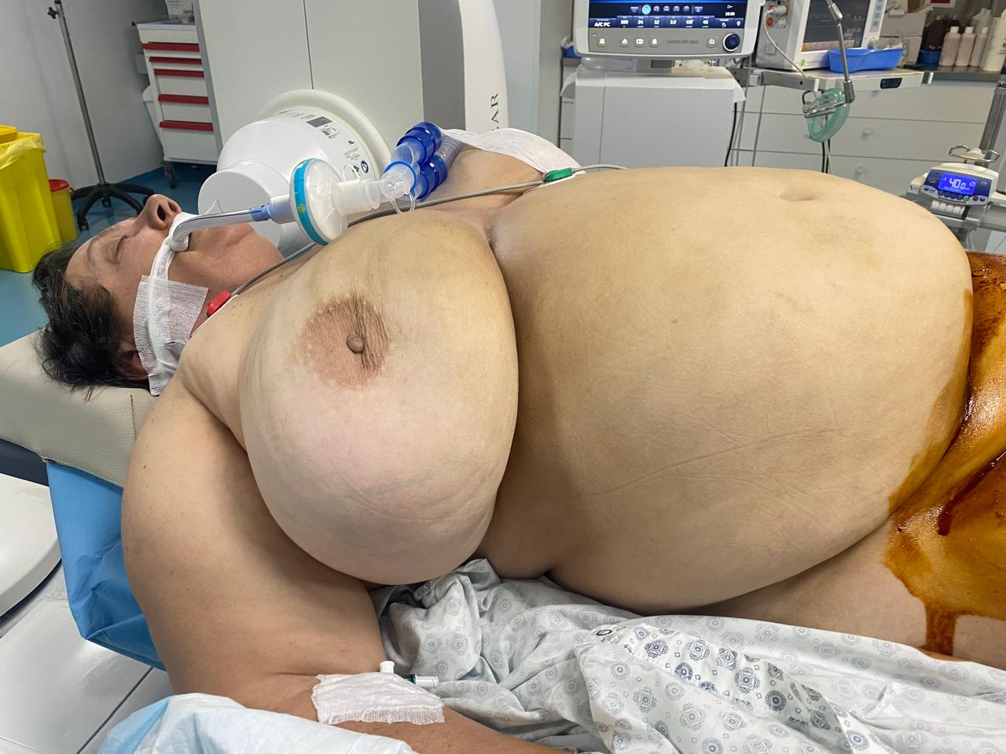

Slide 15
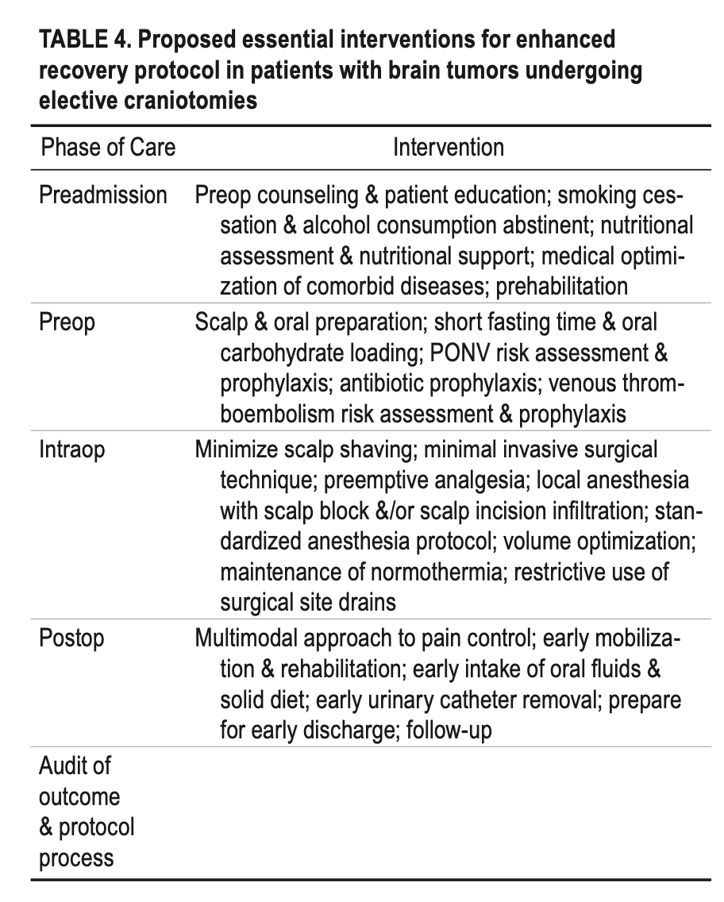
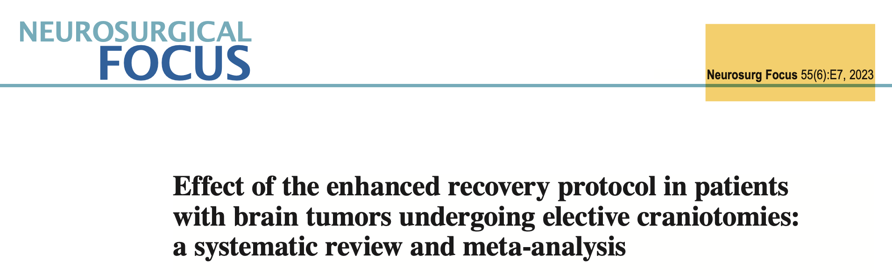
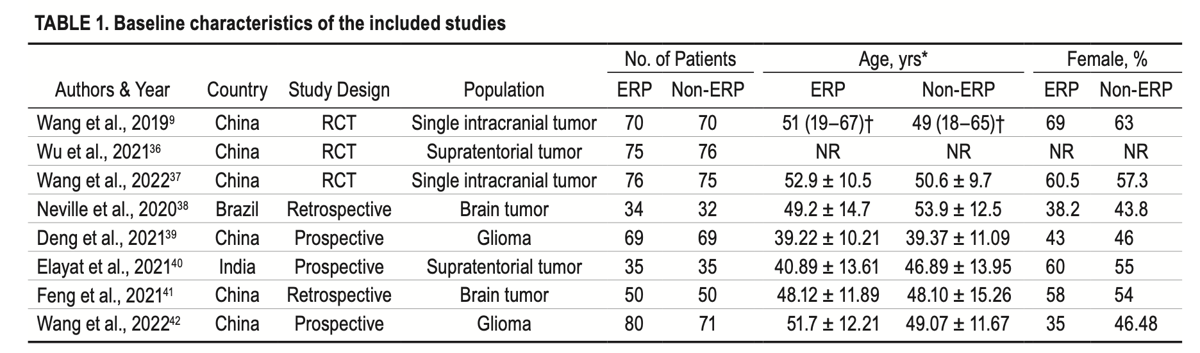

Slide 16
Indications for awake neurosurgery (AN)
Brain tumors
Epileptic foci in proximity to the eloquent brain (language or motor areas)
Brain abscesses

Slide 17
Benefits of awake neurosurgery
Greater extent of resection
Fewer late neurological deficits
Shorter hospital stay
Longer survival

Slide 18
Contraindications
Patient’s refusal
Excessive coughing
Inability to remain unmoved
Obesity
Mood instability

Slide 19
Our experience (25 cases)
Preoperative “speech sedation”
Detailed anesthesia plan
Midazolam 2 mg ev
Ketofol 1:5 continuous infusion till dura opening, then stop sedation
After tumor removal, continue the sedation in the same regimen and ondansetron
Rare moments if pts recall ( e.g., Mayfield) Propofol 10-20 mg
If seizures: local cold saline, Propofol 10-20 mg
None pts got problems, surgeon and neurophysiologist satisfaction and work quality were ok
 | Emer Mbiemer | Mosha | Diganoza | Kohezgjatja
1 | Endrit Thaqi | 20 | Cavernoma front dx | 4.3 h
2 | Halime Mehmetaj | 68 | Low Grade Glioma (LGG) front sn | 3,7 h
3 | Driton Musliu | 25 | LGG front dx | 4.1 h
4 | Samidija Hadroj | 62 | Glioblastome (GB) temp sn | 3,8 h
5 | Ismet Veseli | 54 | LGG front sn | 4.3 h
6 | Ervisa Hazizi | 33 | LGG front dx | 4.1 h
7 | Firdan Lushtiku | 34 | LGG temp sn | 3.8 h
8 | Zeke Nikqi | 40 | GB front sn | 4.5 h
9 | Bashkim Nuhiaj | 52 | GB front sin | 4.2 h
10 | Gezim Krasniqi | 52 | LGG recidive | 2.8 h
11 | Venet Shala | 44 | LGG front dx | 4.8 h
12 | Gresa Brahaj | 22 | Gliome insulare sn | 4.1 h
13 | Ardiana Haxhiaj | 52 | Meta cerebri sin | 3.5 h
14 | Arlind Haliti | 35 | GB prekortikal sin | 4.2 h
15 | Pashk Sadiku | 53 | Oligodentroglioma frontal dx | 3,1 h
16 | Vlora Kurti | 29 | Tu Frontal parasagittal dx | 3.6 h
17 | Sami Podrimaj | 62 | Rolandic dex Glioma | 3.2 h
18 | Arta Ahma | 33 | Gliome frontal dhe kist epidermoid masiv sin (ose glioma bifokale) | U konvertua (vdes pas 2 ditesh me Brain Death)
19 | Enis Salihu | 21 | Cavernoma PT | 2.4 h
20 | Ard Guri | 22 | Low grade glioma prefrontal cortical sin (preop pa deficit, postop me hemiplegji dex) | 2.1 h
21 | Valbona Beqiri | 39 | Gliome multifocale | 3 h
22 | Migert Doksani | 41 | LGG recidive | 3.3 h
23 | Menderes Hyqemi | 62 | LGG cingular dhe frontal dx (beri kriza ne salle) | 4 h
24 | Sofia Abdurrahmani | 67 | Metastaze korteks prefrontal sinister, ca mame | 2.5 h
25 | Lumturie Maliqi | 48 | Metastaze frontale | 3.1 h

Slide 20
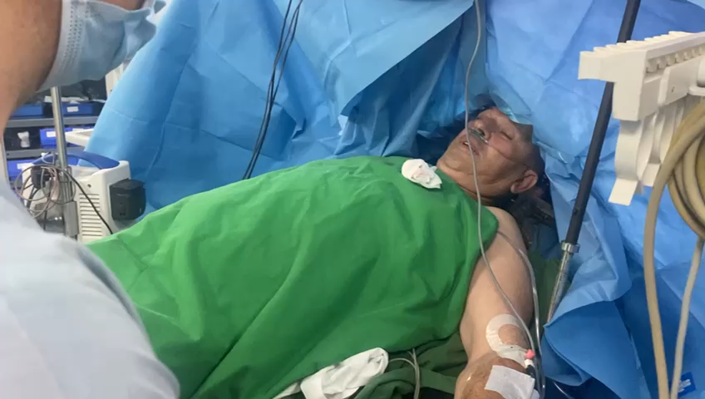
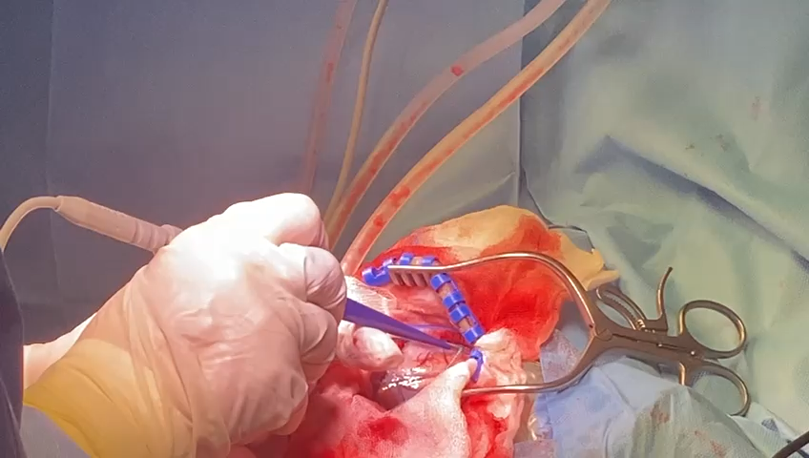
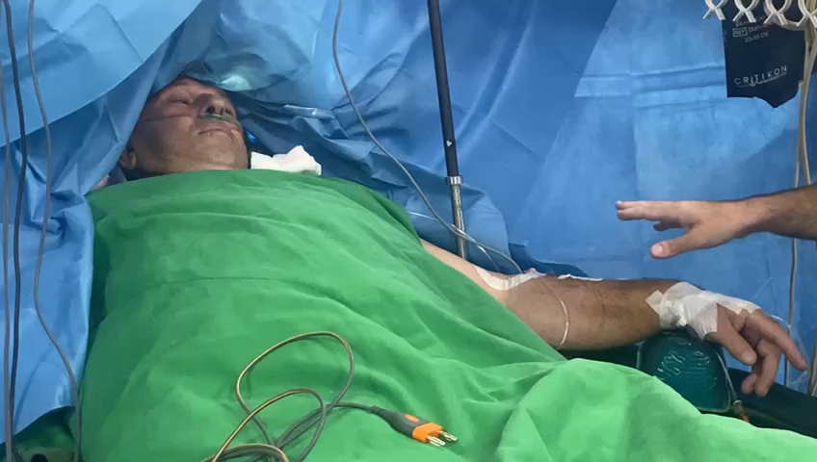
Original views

Slide 21
Taking home messages
Correct indication and selection
ERAS protocol
Awake craniotomy

Slide 22


Thank YOU for attention!

